Slide 1

 | INTERNATIONAL UNIVERSITY – VNU HCMC FINAL TERM EXAMINATION (2024-2025 S1) IT069IU OBJECT-ORIENTED PROGRAMMING
 | Title of topic: ANIMAL KILLING Group [09] – Test room: [LA1.604] Test date: [24 December 2024]

Slide 2





Digital Game Presentation
ANIMAL KILLING
Start Now!

Slide 3









OUR TEAM
Thanh Truc
Bao Tran

Slide 4
TABLE OF CONTENTS
1.
IDEAS & TECHNIQUES
2.
. CORE AND CONCEPTS
3.
GAME DESIGN
4.
. GAMEPLAY DEMO
5.
CONCLUSION

Slide 5




01.
Ideas and TechnIques

Slide 6
MotIVatIon
The Animal Killing project is inspired by the popular chicken shooting games found on platforms like Google Play and the App Store. Built using object-oriented programming principles, the game offers a fresh take on the classic gameplay, incorporating modern mechanics and enhancements to deliver an engaging and immersive experience for players.

Slide 7
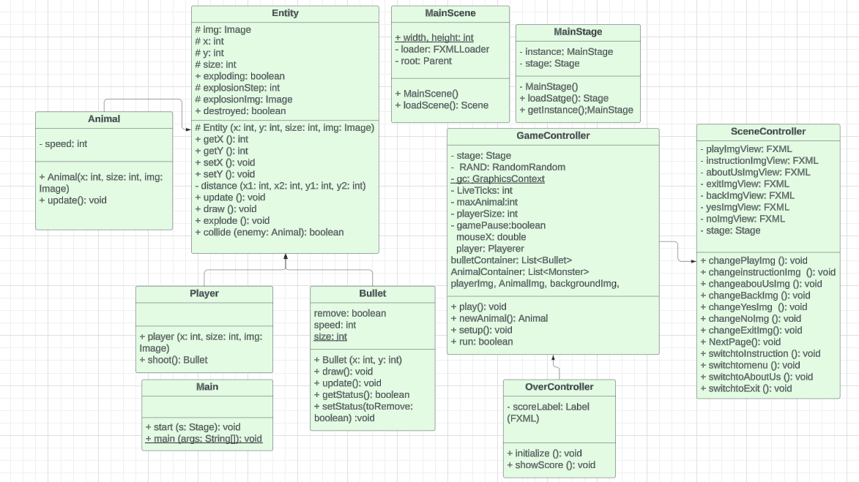
UML

Slide 8





OOP CONCEPTS AND IMPLEMENTATION
02.

Slide 9
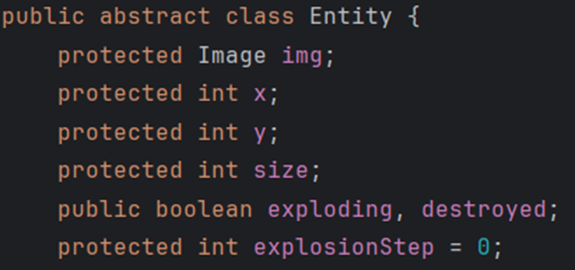
ENCAPSULATION

Slide 10
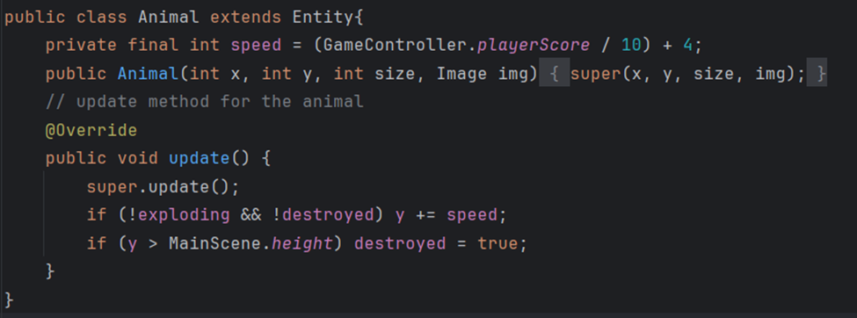
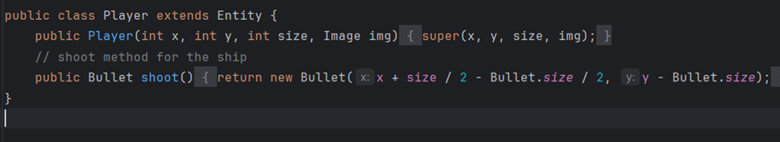
INHERITANCE

Slide 11
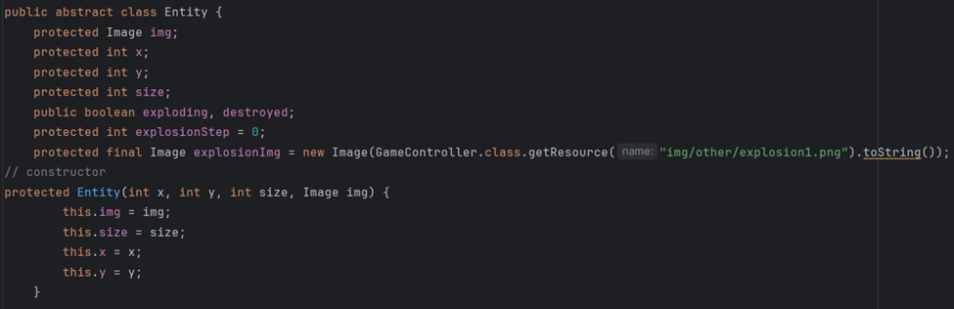
ABSTRACT

Slide 12
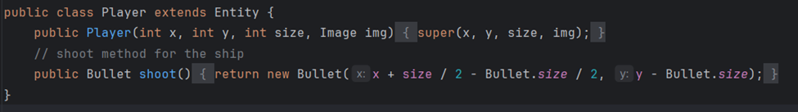
POLYMORPHISM

Slide 13
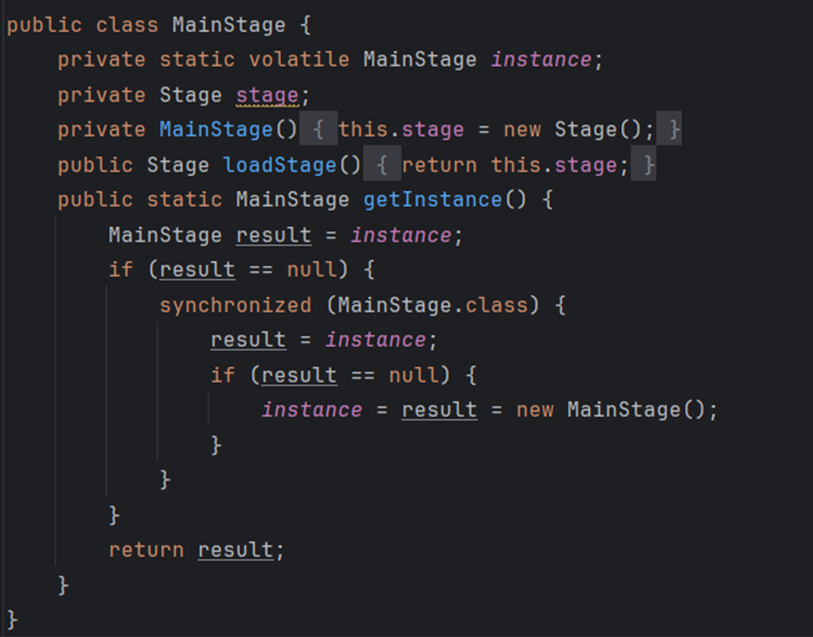
DESIGN PATTERN

Slide 14




03.
Game DESIGN

Slide 15


BACKGROUND

Slide 16

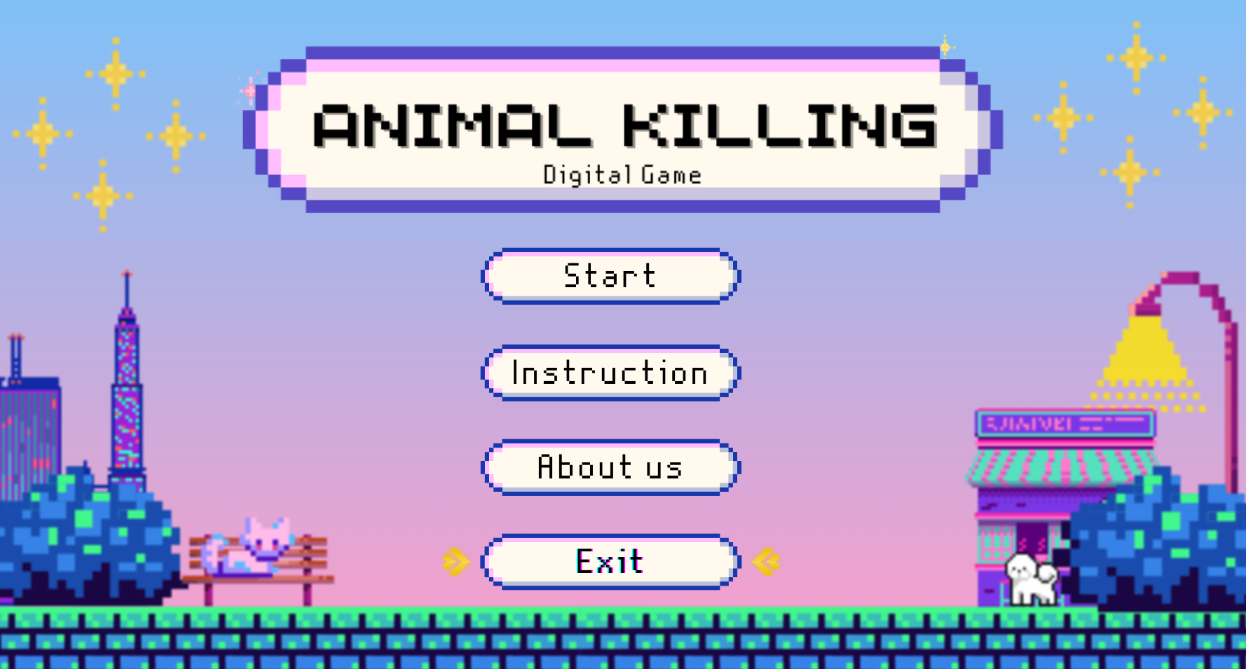
MaIN MENU

Slide 17
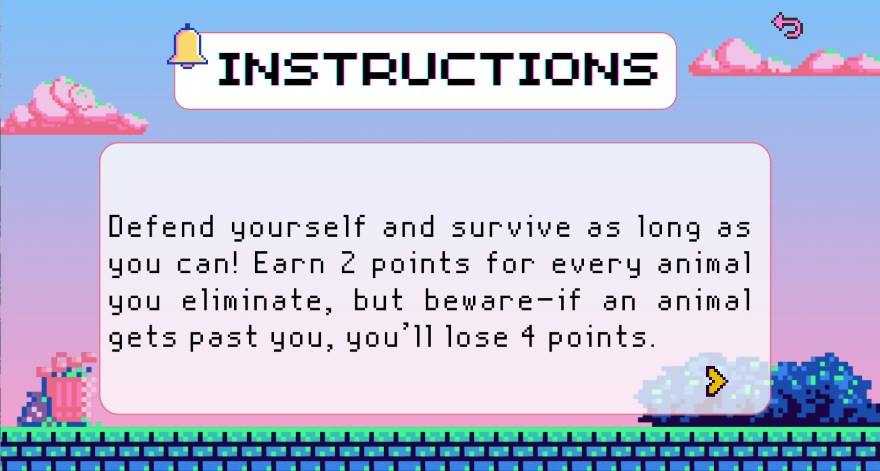
INSTRUCTIONS

Slide 18

ABOUT US

Slide 19


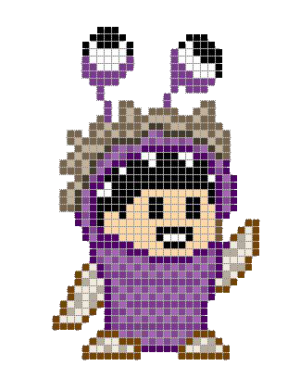



CHARACTeRS

Slide 20

04.
GAMEPLAY DEMO

Slide 21
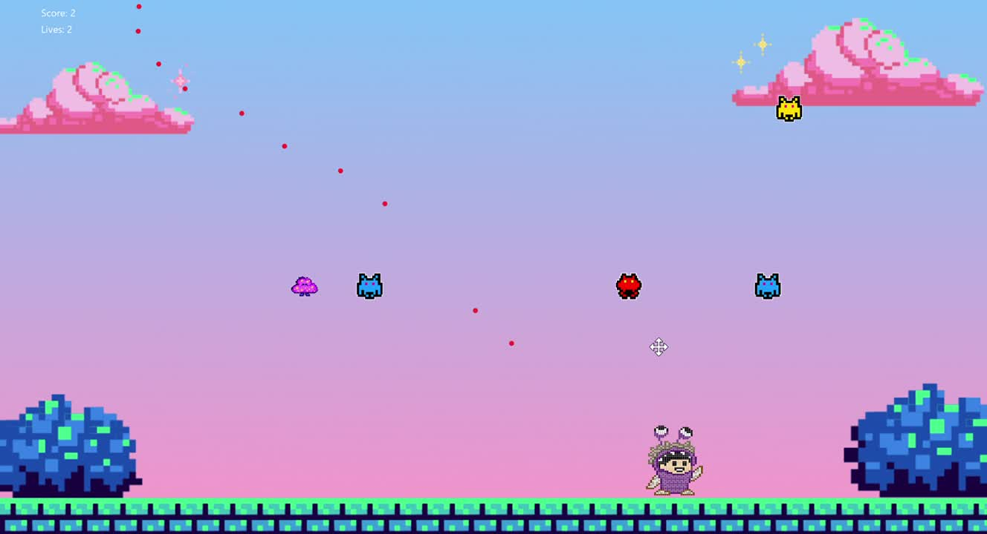

Slide 22






05.
CONCLUSION

Slide 23

ACHIEVEMENT
Effective Use of OOP Principles
User Interface Design
Game Logic Development

Slide 24
FUTURE WORK
Level Progression
Resurrection Mechanic
Player Selection or Random Mode

Slide 25
REFERENCEs
1. mostafaHegab. (n.d.). mostafaHegab/Monster-Inc: Simple Monster Inc Game with
JAVA. Retrieved from https://github.com/mostafaHegab/Chicken-Invaders
2. UML class: Lucidchart. (n.d.). Retrieved from https://lucid.app/lucidchart/c6e383ae-e074-4fc5-ae37-65484a9a7a34/edit?invitationId=inv_0 a814f23-793c-4559-a23f-30c2dc288661&page=HWEp-vi-RSFO#
3. Best 55+ 8. (n.d.). Retrieved from https://wallpapercave.com/w/wp7872568
4. Programming Space Invaders in Java (fx) Tutorial 1/2. (2019). Retrieved from https://www.youtube.com/watch?v=0szmaHH1hno&list=WL&index=4&t=18s
5. Programming Space Invaders in Java (fx) Tutorial 2/2. (2019). Retrieved from https://www.youtube.com/watch?v=dzcQgv9hqXI
6. (N.d.). Retrieved from https://openjfx.io/#
7. Super Pixel Vintage Gaming Presentation. (n.d.). Retrieved from https://slidesgo.com/theme/super-pixel-vintage-gaming?fbclid=IwAR20XFCnI-9j9m-fXtvFr
Vnvp8Cf6NYDbKq0FbsinzJ7hjRIAdrVbHhHqkQ

Slide 26




THANK YOU
See You Next Time!

Slide 27
QUESTION
AND
ANSWER
See You Next Time!

